Slide 1
DISPLAY NODES AT A MAXIMUM DISTANCE OF ‘M’ FROM A SOURCE NODE.
CSPE32 COMBINATORICS AND GRAPH THEORY
MINI PROJECT

Slide 2
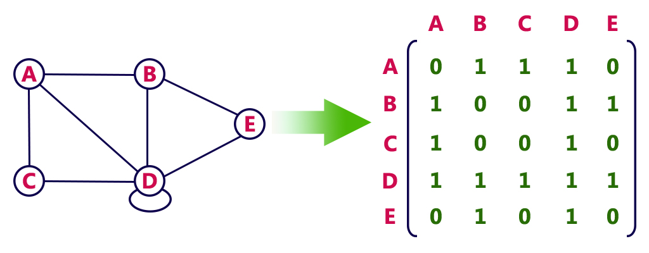
Concepts Involved
Matrix Representation of Graphs

Slide 3
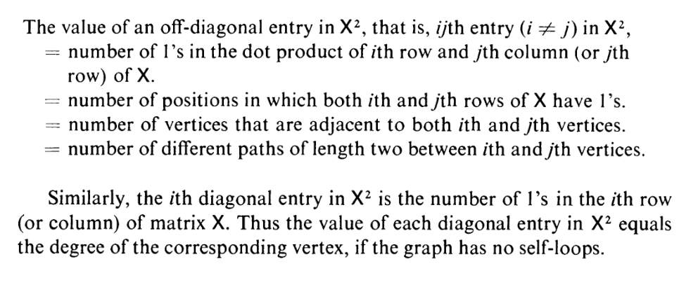
Powers of X

Slide 4
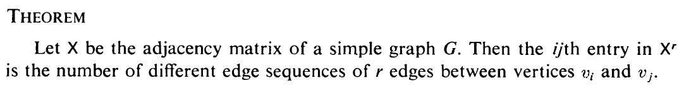
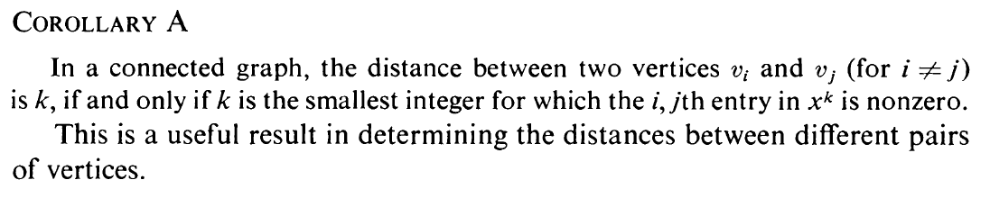

Slide 5
CODE
#include <stdio.h>
#include <stdlib.h>
// Initializing a global array to remember visited nodes. This is done to prevent duplicate elements getting printed.
int visited[100];
// This function is used to get matricx inputs from the user. For test run, I have hard-coded a matrix in the main() function.
// In the test-run, this won't be used.
void getMatrixElements(int matrix[][10], int r, int c)
{
printf("\nEnter elements: \n");
for (int i = 0; i < r; ++i)
{

Slide 6
for (int j = 0; j < c; ++j)
{
scanf("%d", &matrix[i][j]);
}
}
}
// Typical function used to multiply two matrices, and store it back into the first matrix.
void multiplyMatrices(int first[][10], int second[][10], int r1, int c1, int r2, int c2)
{
int result[r1][r1];
for (int i = 0; i < r1; ++i)
{
for (int j = 0; j < c2; ++j)
{
result[i][j] = 0;
}
}

Slide 7
for (int i = 0; i < r1; ++i)
{
for (int j = 0; j < c2; ++j)
{
for (int k = 0; k < c1; ++k)
{
result[i][j] += first[i][k] * second[k][j];
}
}
}
for (int i = 0; i < r1; ++i)
{
for (int j = 0; j < c2; ++j)
{
first[i][j] = result[i][j];
}
}
}

Slide 8
// ============ MAIN FUNCTION =========== //
int main()
{
// Test run sample matrix.
int first[10][10] = {{0, 1, 0, 1, 0, 1, 0, 0, 1, 0},
{1, 0, 1, 0, 1, 1, 0, 0, 0, 0},
{0, 1, 0, 0, 0, 0, 0, 0, 0, 0},
{1, 0, 0, 0, 0, 0, 0, 0, 0, 0},
{0, 1, 0, 0, 0, 0, 0, 0, 0, 0},
{1, 1, 0, 0, 0, 0, 1, 1, 1, 0},
{0, 0, 0, 0, 0, 1, 0, 0, 0, 0},
{0, 0, 0, 0, 0, 1, 0, 0, 0, 0},
{1, 0, 0, 0, 0, 1, 0, 0, 0, 1},
{0, 0, 0, 0, 0, 0, 0, 0, 1, 0}};
// Initializing various variables and arrays.
int second[10][10], result[10][10];
int r1, c1, r2, c2, node, m;
r1 = 10; // Initialized as 10, for the test run case.

Slide 9
//printf("Enter number of elements: "); // Otherwise, we take input from user.
//scanf("%d", &r1);
r2 = r1;
c1 = r1; // Initializing other variables. Here rows and columns all are same.
c2 = r1;
m = 0;
node = 0;
for (int j = 0; j < 100; ++j) // Initializing all elements of visited array to 0
{
visited[j] = 0;
}
// getMatrixElements(first, r1, c1); // Not to be used in test run case.
for (int i = 0; i < r1; ++i) // Duplicates the first array and calls it second. This is done because first and second are the same arrays.

Slide 10
{
for (int j = 0; j < c2; ++j)
{
second[i][j] = first[i][j];
}
}
printf("\nEnter starting node: "); // Takes in the Starting node.
scanf("%d", &node);
printf("\nEnter value of m: "); // Takes in the maximum distance 'm'.
scanf("%d", &m);
printf("\n\nElements at a distance 0: \n"); // Prints elements at distance 0. i.e. the starting node itself.
printf("%d ", node);
visited[node]++;
for (int i = 0; i < m; i++) // Prints elements at distance i, which ranges from 1 to m.
{
printf("\n\nElements at a distance %d: \n", i + 1);
for (int j = 0; j < c1; j++)

Slide 11
{
if (first[node][j] != 0 && visited[j] == 0)
{
printf("%d ", j);
visited[j]++;
}
}
multiplyMatrices(first, second, r1, c1, r2, c2); // Finds the higher power of matrix. Read description at the end of the code.
}
return 0;
}

Slide 12
DESCRIPTION
Given an adjacency matrix X, and a given node "n", we can find nodes at a maximum distance of "m", by calculating various powers of X.
Elements at distance 0 is the element itself, i.e. "n".
Elements at distance 1 are the elements in matrix X, row number "n". Those elements that are adjacent to "n", i.e. X[n][i] = 1 are the
elements that are neighbors to "n". Thus distance is 1.
Elements at distance 2 are the elements in matrix X^2, row number "n". Those elements that have X^2[n][i] >= 1 are the elements that can
be reached from "n" by an edge sequence of length 2. This is the same as elements at a distance 2.
Similarly for elements at distance "m", we just need to find X^m and find those elements that have X^m[n][i] >= 1. which gives the elements
that can be reached from "n" by an edge sequence of length "m". This is the same as elements at a distance m.

Slide 13
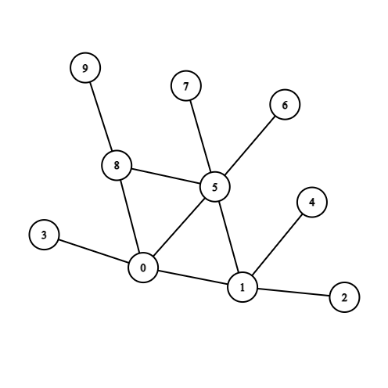
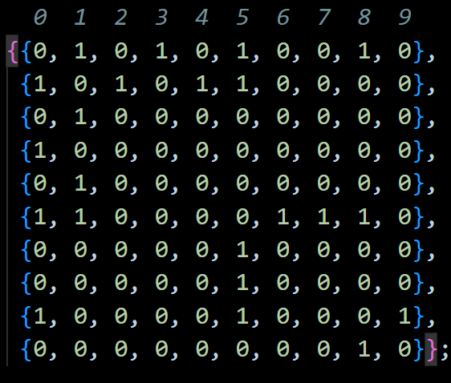
Sample Input

Slide 14
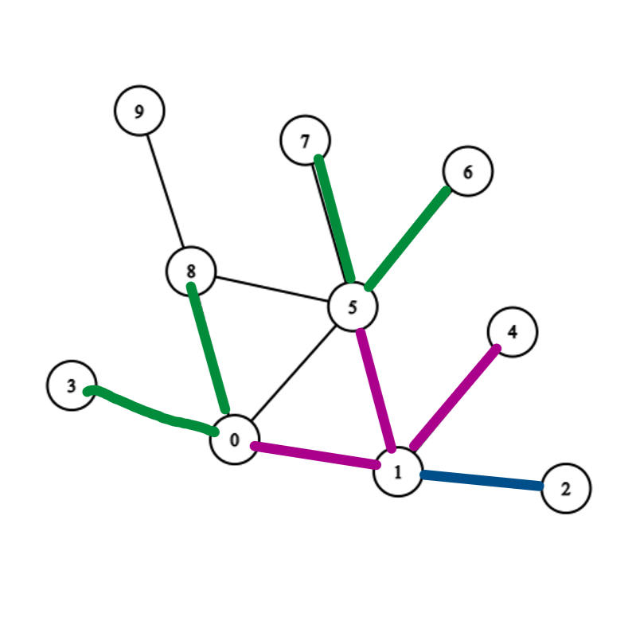
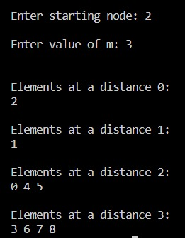
Sample Output

Slide 15
MEMBERS
Bhavika Mahajan - 106121028
Rahul Sriram - 106121100
Rishav Das - 106121102
Swastik Kashyap - 106121136

Slide 16
Individual Contribution
We initially planned multiple methods of solving this problem. The first approach was the Breadth-First Search Algorithm, which was coded and handled by Rishav Das.
We then came up with the idea of Adjacency matrix and its powers, which was explored by Bhavika.
Finally, we sat together and discussed how to implement this strategy. Debugging and user-friendly features were handled by Swastik and Rahul S.
Additionally, the presentation was prepared by Rahul and Bhavika.

